Slide 1

Bank CRM Development Analysis
By:- Prathmesh Satish Potdar

Slide 2


INTRODUCTION
Welcome to the presentation of this analysis project, which aims to improve the bank's retention strategy by better understanding customer behaviour. Utilizing data insights is essential for maintaining competitiveness and guaranteeing long- term success in today's changing industry, where consumer loyalty is key. This project focuses on analyzing various aspects of customer interactions, financial behaviors, and demographic trends to derive actionable insights. By exploring the customer churn patterns, spending habits, and response to marketing initiatives, I aimed to develop strategies that not only retain existing customers but also attract new ones.
The project utilizes a robust dataset encompassing customer information, transaction details, credit scores, and demographic profiles. Through advanced analytics and visualization techniques, I have uncovered valuable insights that will guide in making data-driven decisions to optimize customer satisfaction and business growth.
Let's dive into the details of our data journey and explore the insights that will
drive into the strategic initiatives going forward.

Slide 3

SUMMARY
"This project delves into customer churn and retention analysis within a bank, employing data-driven insights to uncover trends and patterns influencing customer behavior. By examining factors like demographics, account activity, and product usage, the project aims to identify high-risk customer segments and propose targeted strategies for enhancing customer retention. The ultimate goal is to leverage data analytics to optimize customer satisfaction, reduce churn rates, and drive sustainable growth for the bank."

Slide 4




Analytical Approach & Tools
Data Cleaning and Formatting
Used Excel for initial data cleaning tasks, including removing duplicates, and formatting columns for consistency.
Conducted data profiling to understand the dataset's structure, identify patterns, and assess data quality.
Data Storage and Manipulation
Imported the Excel Data into SQL database
Analyze the customer churn by writing SQL Queries to correlate customer attributes with the churn rates.
Data Analysis and Visualization
Used the queries and original files to process data in Power BI
Develop interactive dashboards to display balance details, churn rates and customer details.

Slide 5
Analyzing Problem Statement
1.
During the previous fiscal year, Capstone Bank experienced a notable level of customer churn , prompting management to enlist the expertise of analytical specialists to devise solution.
2.
Analyze the profitability of each customer segment to prioritize high-value customers and tailor products and services accordingly.

Slide 6

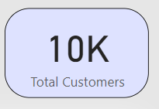
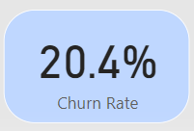
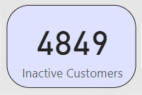
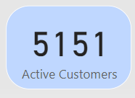
Customer Overviews
Total Customers
Churn Rate
Total Active Customer
Total Inactive Customer

Slide 7
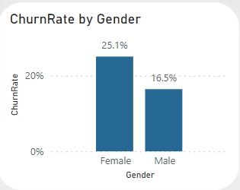
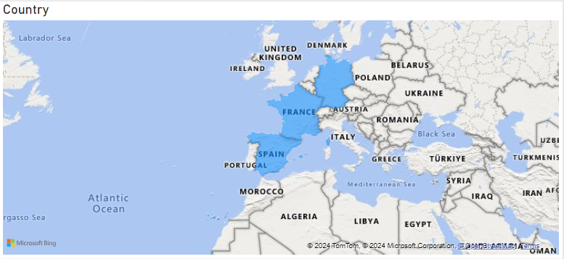
Identify Locations and Gender Where Churn Rate is More
Analysis of the dataset indicates that Germany experienced a noticeable elevated churn rate in comparison to other countries. Moreover, Female customers exhibit a higher likelihood of churning when just a posed with their male counterparts.

Slide 8
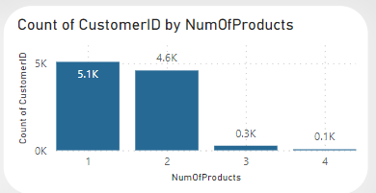
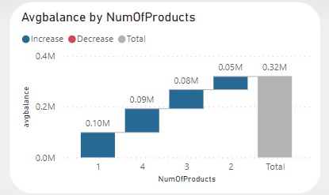
Analyzing the Customer Segments for Potential Churn
Findings reveal that customers who exclusively utilize a single product from the bank display a heightened propensity for churn, suggesting a distinct customer segment at risk.

Slide 9
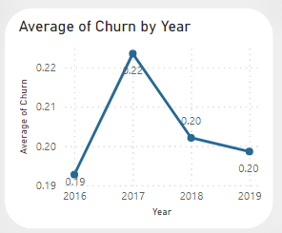
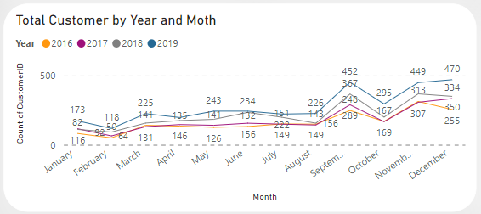
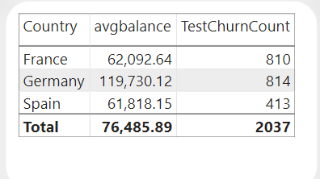
Propose Measures to Decrease Churn Rate
The bank observes a positive trend in customer acquisition, with the number of new customers steadily rising each year, signaling a favorable development. Furthermore, there’s a corresponding decline in the churn rate over the same period, indicating an encouraging trajectory. To leverage this trend and further mitigate churn, it’s imperative to prioritize initiatives aimed at boosting customer acquisition annually. Additionally, targeted marketing efforts should be directed toward countries such as Germany and France , where the churn rate is notably high, with 841 and 810 churned customers respectively, in order to effectively address this issue.

Slide 10
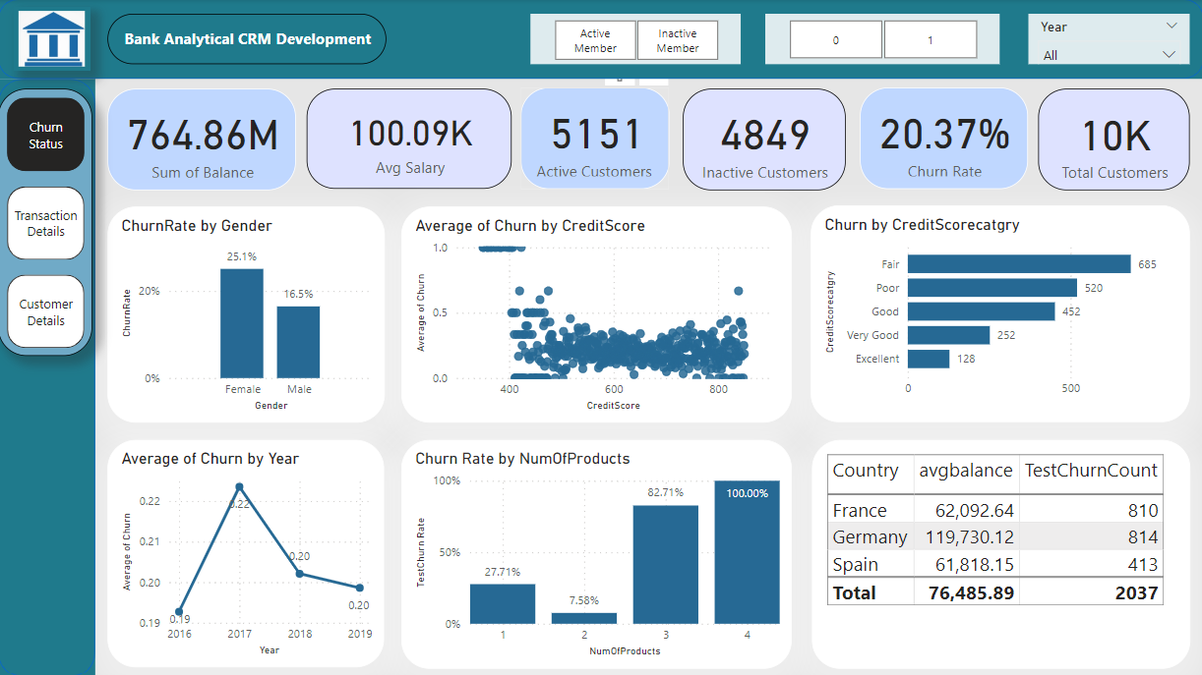
Dashboard Visualization

Slide 11
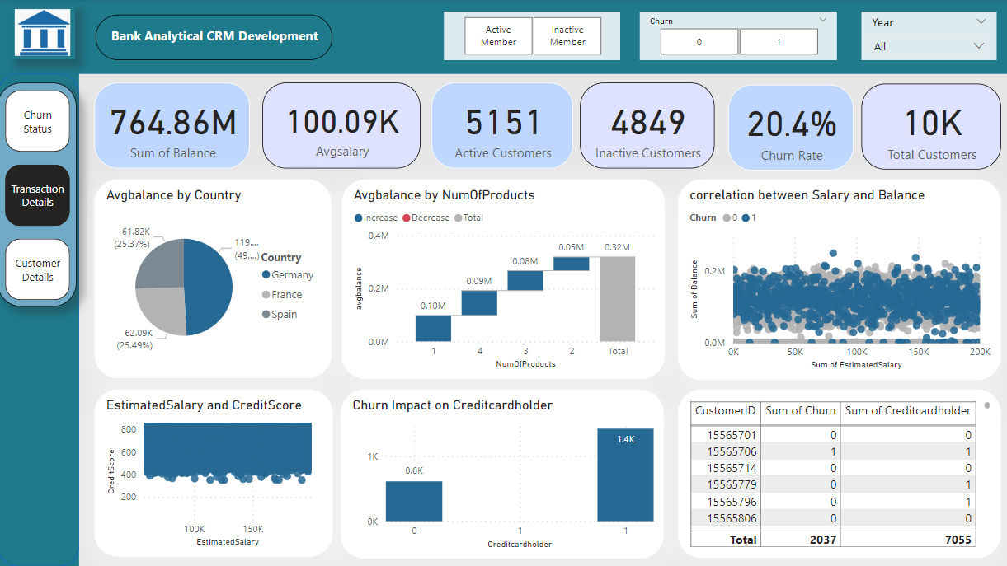
Dashboard Visualization

Slide 12
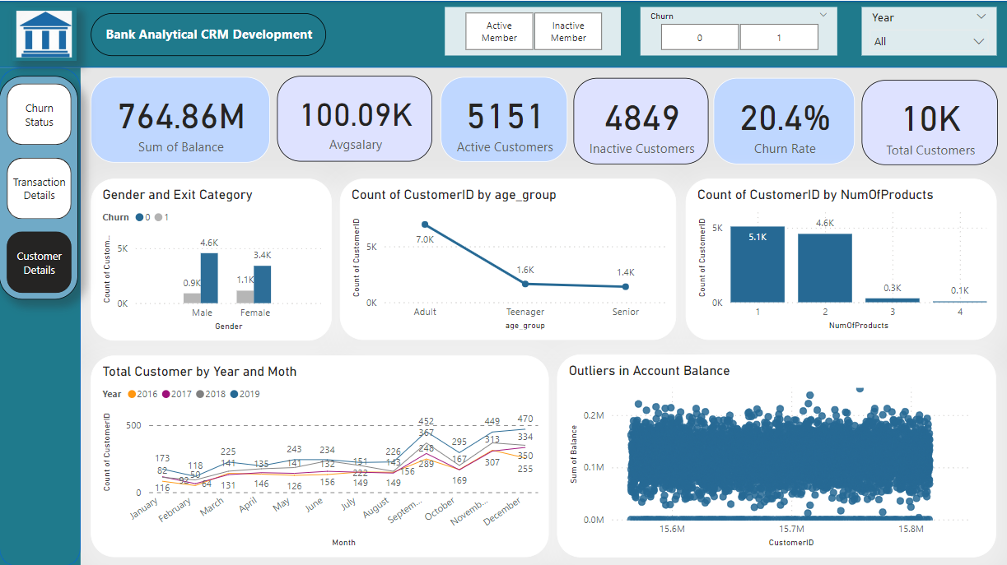
Dashboard Visualization

Slide 13
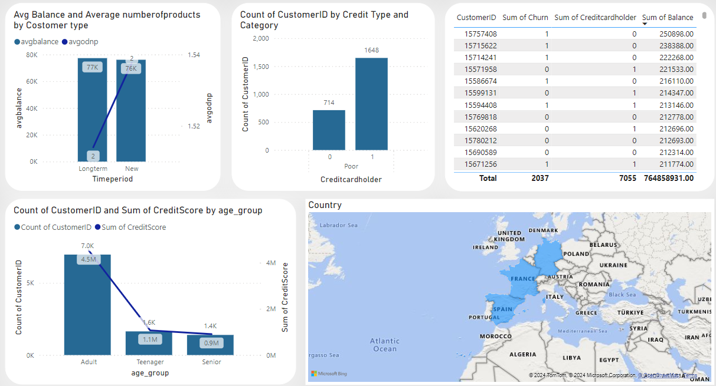
Dashboard Visualization

Slide 14

Conclusion
The project delved into the intricacies of customer churn analysis within the banking sector. We gained valuable insights into customer behaviors, risk factors, and market trends. We identified key metrics such as churn rates, customer demographics, and product usage patterns, enabling us to formulate data-driven strategies for customer retention and acquisition.
However, it's crucial to note that customer churn is a complex phenomenon influenced by various factors beyond the scope of our dataset, such as customer experiences, market competition, and economic conditions. Therefore, while our analysis provides valuable insights, a holistic approach incorporating customer feedback, qualitative data analysis, and continuous monitoring is essential for sustained success in reducing churn and enhancing customer satisfaction.

Slide 15

Thank you

